Slide 1

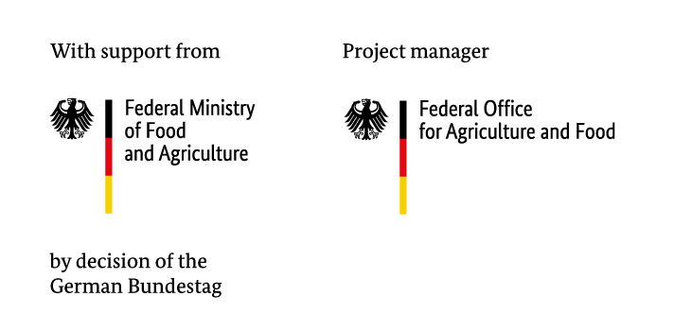









Research title
Nutrition Intervention Forecasting and Monitoring
Providing evidence based decision support for better nutrition in Vietnam and Myanmar
Autors names here

Slide 2
Please replace the Uni Bonn logo with your own insitute‘s logo

